Slide 1
Employee Data Analysis using Excel
STUDENT NAME: RAMYA K
REGISTER NO: 312209341
NAAN MUDHALVAN ID: asunm1353312209341
DEPARTMENT: BACHELOR OF COMMERCE (GENERAL)
COLLEGE: ANNA ADARSH COLLEGE FOR WOMEN

Slide 2
PROJECT TITLE
Employee Training Analysis using Excel

Slide 3


AGENDA
Problem Statement
Project Overview
End Users
Our Solution and Proposition
Dataset Description
Modelling Approach
Results and Discussion
Conclusion
3/21/2024 Annual Review

Slide 4
PROBLEM STATEMENT
In the rapidly evolving job market, professionals across various industries need to continuously upgrade their skills to stay competitive. Excel, a powerful tool for data management and analysis, is frequently required in many job roles. However, there is a gap in the effective training of employees on advanced Excel features, leading to inefficient use of the tool and missed opportunities for data-driven decision-making.
To develop and implement a comprehensive training program that equips employees with advanced Excel skills, enhancing their ability to manage, analyze, and visualize data effectively. The training program should address common pain points and enable employees to apply Excel's advanced features to real-world scenarios in their specific job roles

Slide 5
PROJECT OVERVIEW
Develop Performance Tracking System: Design an Excel-based system to track key performance indicators (KPIs) and metrics relevant to employee performance.
Enhance Data Analysis: Utilize advanced Excel functions to analyze performance data and generate actionable insights.
Create Reporting Templates: Develop templates and dashboards for generating regular performance reports and visualizations.
Facilitate Data-Driven Decisions: Enable managers to use the data to make informed decisions regarding employee development, recognition, and improvement.
Provide Training and Support: Offer training and support to ensure effective use of the performance tracking system

Slide 6

WHO ARE THE END USERS?
Employer
Employee
Organisation

Slide 7
OUR SOLUTION AND ITS VALUE PROPOSITION
Customizable Performance Dashboards: Visualize key performance indicators (KPIs) and metrics through interactive charts and graphs.
Automated Reporting Templates: Generate standardized performance reports and summaries with pre-defined templates.
Advanced Data Analysis: Utilize pivot tables, complex formulas, and conditional formatting to analyze performance data.
Real-Time Data Entry and Updates: Enable real-time updates and data entry to ensure accurate and up-to-date performance tracking.
User Guides and Training Materials: Provide comprehensive documentation and training resources for effective use of the system.

Slide 8
Dataset Description
Employee Information:
Columns: Employee ID, Name, Department, Position, Hire Date, Manager
Description: Basic demographic and employment details for each employee.
Performance Metrics:
Columns: Employee ID, Review Period, KPI 1 (e.g., Sales Targets), KPI 2 (e.g., Customer Satisfaction Score), KPI 3 (e.g., Project Completion Rate), Overall Rating
Description: Key performance indicators and overall performance ratings for each review period.
Performance Reviews:
Columns: Employee ID, Review Date, Reviewer, Comments, Rating (e.g., 1-5 scale), Development Areas
Description: Detailed review comments and ratings from performance evaluations, including feedback and areas for improvement.
Training and Development:
Columns: Employee ID, Training Program, Completion Date, Skills Acquired, Post-Training Performance Improvement
Description: Records of training programs attended, skills gained, and subsequent impact on performance

Slide 9
THE "WOW" IN OUR SOLUTION
Dynamic Dashboards: Our solution features interactive dashboards that visually represent key performance metrics, allowing users to quickly grasp complex data through intuitive charts and graphs. This makes data interpretation easier and more engaging.
Automated Insights: With built-in formulas and pivot tables, the system provides automated insights and trend analysis. This reduces manual data manipulation and speeds up the process of identifying performance patterns and anomalies.
Real-Time Data Updates: The system allows for real-time data entry and updates, ensuring that performance information is always current. This feature supports timely decision-making and keeps all stakeholders informed with the latest data.
Customizable Templates: Users can easily customize reporting templates to fit specific organizational needs, allowing for personalized performance reports and evaluations that align with company standards.
9

Slide 10
MODELLING
1. Data Structuring:
Employee Info: Employee ID, Name, Department, Position.
Performance Metrics: Employee ID, Review Period, KPIs, Overall Rating.
Performance Reviews: Employee ID, Review Date, Reviewer, Rating, Comments.
Training: Employee ID, Training Program, Skills Acquired, Performance Improvement.
Department Summary: Department, Review Period, Average KPIs, Average Rating.
Trend Analysis: Employee ID, KPI Trends, Performance Over Time.
2. Modelling Techniques:
Data Validation: Ensure accurate data entry with dropdown lists.
Formulas: Use AVERAGE, SUM, COUNTIF, IF for calculations.
Pivot Tables: Summarize and analyze data dynamically.
Conditional Formatting: Highlight key metrics for easy identification.
Charts/Graphs: Visualize data trends and comparisons.
Dashboards: Create interactive views of key metrics.
Automated Reports: Generate periodic reports with pre-defined templates
10

Slide 11
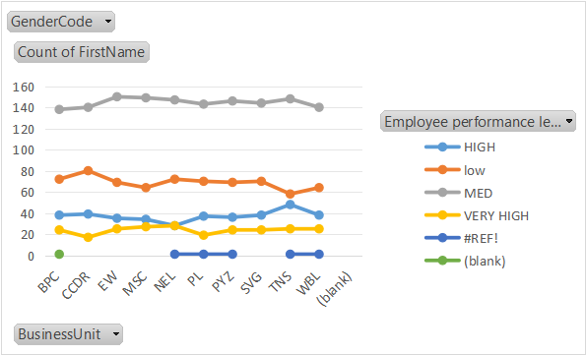
RESULTS
GenderCode | (ALL)
Count of FirstName | Employee performance level
BusinessUnit | HIGH | low | MED | VERY HIGH | Grand Total
BPC | 38 | 72 | 138 | 24 | 273
CCDR | 39 | 80 | 140 | 17 | 276
EW | 35 | 69 | 150 | 25 | 279
MSC | 34 | 64 | 149 | 27 | 274
NEL | 28 | 72 | 147 | 28 | 276
PL | 37 | 70 | 143 | 19 | 270
PYZ | 36 | 69 | 146 | 24 | 276
SVG | 38 | 70 | 144 | 24 | 276
TNS | 48 | 58 | 148 | 25 | 280
WBL | 38 | 64 | 140 | 25 | 268
(blank)
Grand Total | 371 | 688 | 1445 | 238 | 2748

Slide 12
conclusion
Enhanced Efficiency: Streamlines performance tracking and data analysis, reducing manual effort and improving productivity.
Data-Driven Decisions: Facilitates informed decision-making with accurate, real-time insights into employee performance.
Customizability: Adapts to organizational needs with customizable metrics and reporting templates.
Cost-Effective: Utilizes existing Excel tools, offering a powerful solution without the need for expensive software.

